Slide 1
TRANSIMS Version 5 Network Files
January 20, 2011
David Roden – AECOM

Slide 2
Topics
Overall goals and objectives
Major concept changes
File structure changes
New data fields and features
Presentation graphics

Slide 3
Goal – Improved User Interface
Simplify editing
Simplify the network coding requirements
Reduce the number of coded dependencies between files
Use data nesting to avoid sorting problems and record inconsistencies
Reduce user errors
Standardize control keys and key definitions
Directory and key names are the same as other files
Key names are simplified and clarified
Interpret user-provided unit specifications
More intuitive/familiar units of measure (e.g., 25.3 mps = ??? mph)
Simplify coding and editing

Slide 4
Goal – More Advanced Applications
Enhance capabilities
Coordinated signal timing and phasing plans
Intersections coded with multiple nodes (e.g., divided arterials)
Near-by signal coordination and traffic circles
Metered or random vehicle processing rates by lane
Toll plazas, ramp metering, security gates
Vehicle type cost by lane and time of day
HOT lanes and variable tolls
Parking cost and access/egress times by time of day
Parking lot choice
Impact of vertical grades on truck speeds

Slide 5
Major Concept Changes
Lane numbers and pocket lanes
Multi-node signals
Toll lanes and lane processing rates
Process links → access links
Link offsets

Slide 6
File Structure Changes
Lane ranges
Link direction
link-node → link-dir
Parking time period nests
Nested signal files
Signal time periods, timing plans, and phasing plans
Transit schedules
route-run-stop list → route-stop-run columns (i.e., time tables)

Slide 7
New Data Fields
Node – subarea
Link – area type, grade, divided
Location – XY → link, offset, setback
Parking – time-in, time-out
Lane Use – toll, fixed and variable processing rates
Timing Plans – cycle length
Phasing Plans – movement
Detectors – use type

Slide 8
Facility Type Numbers
Version 4 → Version 5
1 = Freeway Freeway
2 = Expressway Expressway
3 = Principal Principal Arterial
4 = Major Major Arterial
5 = Minor Minor Arterial
6 = Collector Collector
7 = Local Local Thru
8 = Frontage Local
9 = Ramp Frontage Road
10 = Bridge Ramp
Version 4 → Version 5
11 = Walkway Bridge
12 = Bikeway Tunnel
13 = Busway Other
14 = Light Rail Walkway
15 = Heavy Rail Bikeway
16 = Ferry Busway
17 = External Light Rail
18 = Heavy Rail
19 = Ferry
20 = External

Slide 9
Lane Numbers
The link file no longer tracks pocket lanes
Pocket lanes are numbered separately – L1, R1
Lanes are now numbered from right to left
Greater consistency with other simulation packages and HCM
Version 4
1
Version 5
L1
2
3
3
2
4
1
Link File:
3 thru lanes
1 left pocket
1 right pocket
5
Link File:
3 lanes
R1
Pocket File:
lane 1 turn
lane 5 turn
Pocket File:
1 right turn
1 left turn

Slide 10
Lane Number Usage
Impacted network and output files
Link, Pocket, Lane-Use, Detector
Lane Connectivity → Connection
Problem, Snapshot, Occupancy
Lane coding
Version 4: most files require separate records for each lane or lane combination
Version 5: all files use lane ranges or lane range combinations
Lane range examples: 1..3, R1..3, 3..L1, L1..L2, ALL
Fewer records to edit, add, delete, sort
Fewer coding errors and less time consuming
Software builds and validates the lane relationships

Slide 11
Lane Range Example – Lane Use
Limit all lanes to HOV in the AM Peak period
Version 4
1
Version 5
L1
2
3
3
2
4
1
5
R1
Lane Use Records:
Lane 1, HOV, period, etc .
Lane 2, HOV, period, etc.
Lane 3, HOV, period, etc.
Lane 4, HOV, period, etc.
Lane 5, HOV, period, etc.
Lane Use Records:
Lanes ALL, HOV, period, etc.
or
Lanes R1..L1, HOV, period, etc.

Slide 12
Add a Pocket Lane in Version 4
Add a pocket lane to a link with parking restrictions
1
1
2
2
to
3
3
off-peak parking
4
off-peak parking
Link File:
3 thru lanes
0 left pocket
0 right pocket
Link File:
3 thru lanes
1 left pocket
0 right pocket
Lane Use File:
Lane 3, closed, period 1
Lane 3, closed, period 2
Lane 3, closed, period 3
Lane Use File:
Lane 4, closed, period 1
Lane 4, closed, period 2
Lane 4, closed, period 3
Pocket File:
lane 1 turn

Slide 13
Add a Pocket Lane in Version 5
Add a pocket lane to a link with parking restrictions
L1
3
3
2
to
2
1
off-peak parking
1
off-peak parking
Link File:
3 thru lanes
Link File: (no change)
3 thru lanes
Lane Use File:
Lane 1, closed, period 1
Lane 1, closed, period 2
Lane 1, closed, period 3
Lane Use File: (no change)
Lane 1, closed, period 1
Lane 1, closed, period 2
Lane 1, closed, period 3
Pocket File:
1 left turn

Slide 14
Link Connection Impacts
Version 4
Lane numbers apply to both ends of the link
Pocket lanes at one end impacts lane numbers at the other end
Adding and deleting pocket lanes impacts all lane-related files
Version 5
Lane numbers at each end are independent
Pocket lane changes require relatively few network changes

Slide 15
Version 4 Lane Connectivity Edits
1
1
1
2
2
2
3
3
3
1
1
1
add
1
2
1
2
3
2
3
4
3
1
1
Lane Connectivity:
Lane 1 to 1 → Lane 1 to 2
Lane 2 to 2 → Lane 2 to 3
Lane 3 to 3 → Lane 3 to 4
Lane 1 to 3 → Lane 1 to 4
Lane Connectivity:
Lane 1 to 1 → Lane 2 to 1
Lane 2 to 2 → Lane 3 to 3
Lane 3 to 3 → Lane 4 to 2
Lane 3 to 1 → Lane 4 to 1

Slide 16
Version 5 Connection Edits
3
3
3
2
2
2
1
1
1
1
1
L1
add
3
3
3
2
2
2
1
1
1
1
1
Connection File:
Lane 1..3 to 1..3 (no change)
Lane 1 to 1 (no change)
Connection File:
Lane 1..3 to 1..3 (no change)
Lane 1 to 1 (no change)

Slide 17
Link Offset
Link offsets are measured from the beginning of the link in the direction of travel
Version 4
Network offsets are measured from the end of the link
Microsimulator offsets are measured from the beginning of the link
Parking
Offset
Offset
Parking
Offset
Parking
Vehicle Offset
Parking
Offset

Slide 18
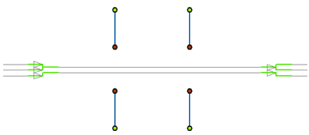


Process Links → Access Link
Version 5 does not need Process Links
Link-offsets are used to build direct two-way connections
Access Links are only used for special connections
Two-way or one-way links between nodes, locations, parking lots, and transit stops
Version 4.0
Version 5.0
Parking
Parking
Location
Setback
2 one-way
Process Links
Activity
Location
Location

Slide 19
Access Link Options
Version 4 process links are required to connect
activity locations ←→ parking and activity locations ←→ transit stops
Version 5 access links may connect
locations ←→ parking, locations ←→ stops, locations ←→ nodes
locations ←→ locations, stops ←→ stops, nodes ←→ nodes
parking ←→ stops, parking ←→ nodes, stops ←→ nodes
Walk links with travel time, distance, and cost
Transit stops no longer need activity locations
Activity locations with a zero zone number are deleted

Slide 20
Lane Use File
Version 5 differences
Lane ranges, direction code, offsets, length units
Version 4 toll file → Version 5 lane use file
Enables tolls by lane (e.g., HOT lanes)
Lane processing rate added
Fixed and variable/random vehicle delays
Toll plazas, ramp metering, security gates

Slide 21
Parking File
Nested record structure
Single and unique parking lot location – link-offset and type
Time-of-day and use/vehicle type nests
Variable parking costs
Access and egress times (~terminal time)
Time required to park or un-park the vehicle
Parking spaces
Shadow prices or access time can be used to model capacity constraints

Slide 22
Traffic Signals
Signalized node → signal controller
Four cross-referenced files
Signal, Timing Plan, Phasing Plan, Detector
Signal Coordinator file dropped
Primary differences
Multi-node signal coordination
Re-usable timing and phasing plans
Barrier, ring, and position codes
Greater compatibility with traffic signal software
Detectors include use types (e.g., buses or trains)
Nested file structures for tighter record management and fewer coding errors

Slide 23
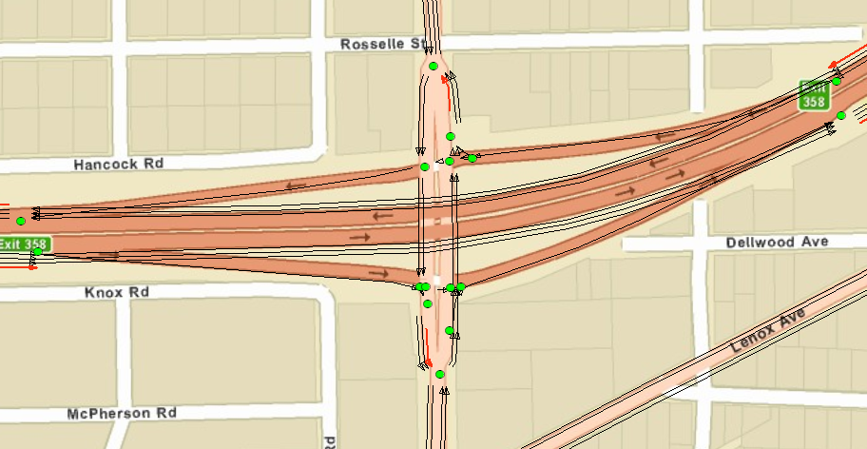
Multi-Node Signal Controllers

Slide 24
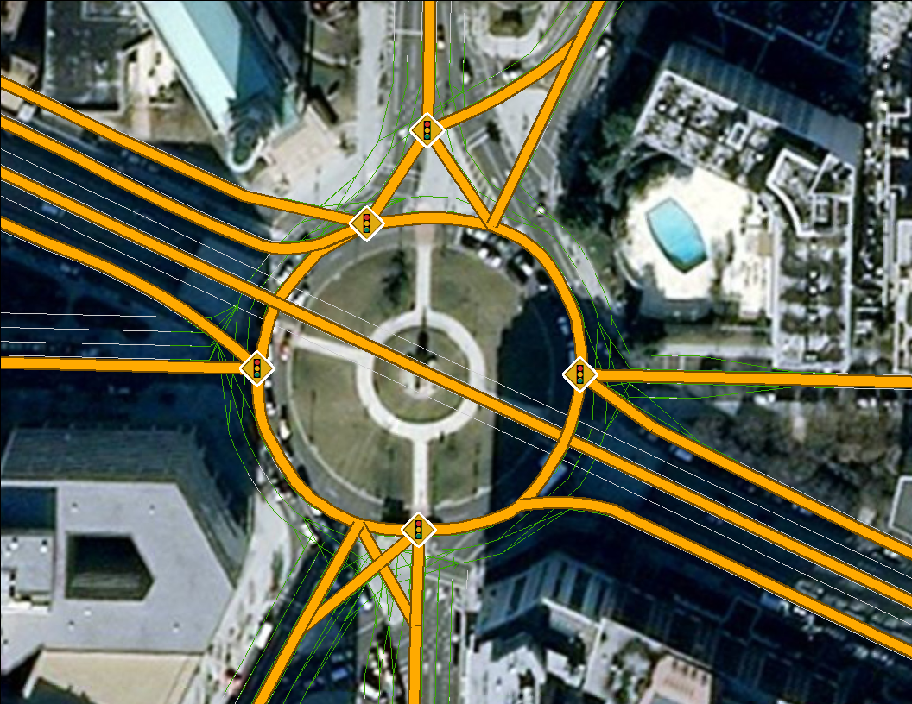
Traffic Circles

Slide 25
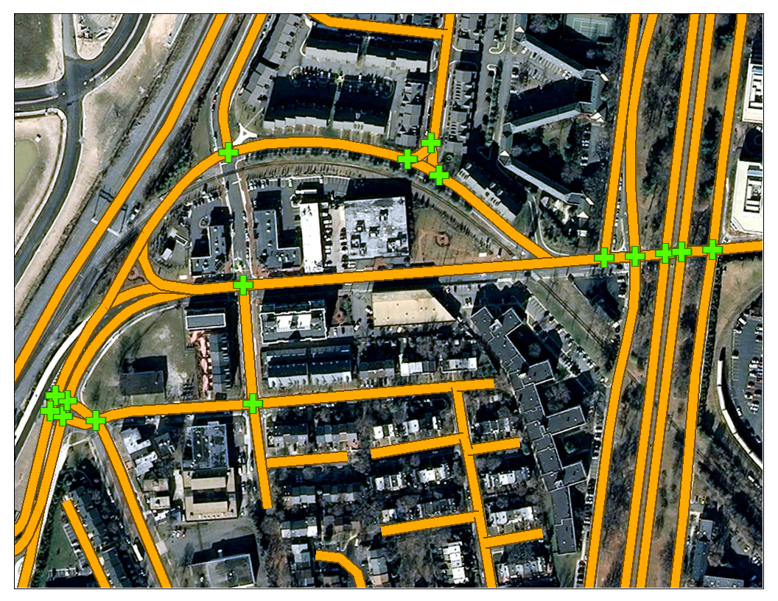
Divided Roadways

Slide 26
Signal File
Version 5 differences
Node → controller number
Controls a list of nodes
Nested time period records (with end times)
Improve record management and minimize coding mistakes
Re-useable timing and phasing ID numbers
Signal | Group | Times | Nodes
Start | End | Timing | Phasing
1 | 2 | 5 | 101|102|103
0:00 | 6:00 | 1 | 1
6:00 | 9:30 | 2 | 1
9:30 | 16:00 | 1 | 1
16:00 | 19:00 | 3 | 1
19:00 | 27:00 | 1 | 1

Slide 27
Timing Plan File
Version 5 differences
Controller number + timing ID indexing
Signal type (timed/actuated), offset, and cycle length
Nested phase records
Improve record management and minimize coding mistakes
Barrier, ring, and position codes
Clearer sequencing and improved linkages to traffic signal software
Signal | Timing | Type | Cycle | Offset | Phases | Notes
Phase | Barrier | Ring | Position | Min_Green | Max_Green | Extension | Yellow | All_Red
1 | 1 | Actuated | 100 | 0 | 4 | 0:00..6:00
1 | 1 | 1 | 1 | 5 | 5 | 0 | 0 | 0
2 | 1 | 1 | 2 | 20 | 39 | 12 | 3 | 1
3 | 1 | 1 | 3 | 5 | 9 | 3 | 0 | 0
4 | 1 | 1 | 4 | 20 | 39 | 12 | 3 | 1

Slide 28
Phasing Plan File
Version 5 differences
Node → controller number and direction code
Multi-node signals and cross-referencing
Nested movements records
Improve record management and minimize coding mistakes
Movements descriptions
User help and improved linkages to traffic signal software
Signal | Phasing | Phase | Movements | Detectors
Movement | Link | Dir | To_Link | Protection
1 | 1 | 1 | 4 | 1|3
EB_Left | 4892 | 1 | 3164 | Protected
WB_Left | 4202 | 0 | 439 | Protected
NB_Right | 439 | 0 | 4202 | Stop_Permit
SB_Right | 3164 | 1 | 4892 | Stop_Permit

Slide 29
Detector File
Version 5 differences
Node → direction code
Offset from the beginning of the link (meters/feet)
Lane ranges with pocket lane codes
Use types
No signal coordinator
Detector | Link | Dir | Offset | Length | Lanes | Type | Use | Notes
1 | 4892 | 1 | 1043.5 | 30 | L1 | Presence | Any | Left Turn
2 | 4892 | 1 | 1043.5 | 30 | R1..2 | Presence | Any | Thru Right
3 | 4202 | 0 | 1137.9 | 30 | L1 | Presence | Any | Left Turn

Slide 30
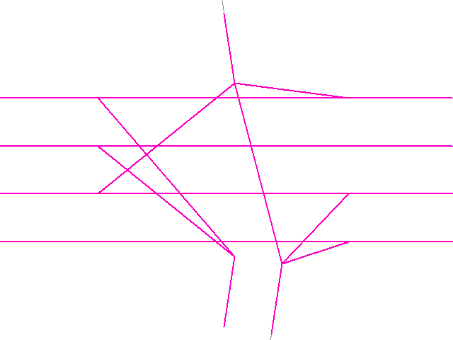
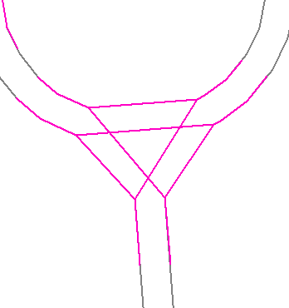
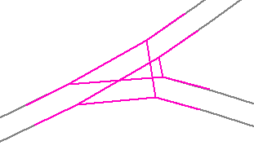
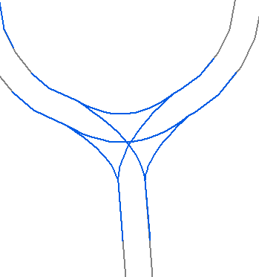
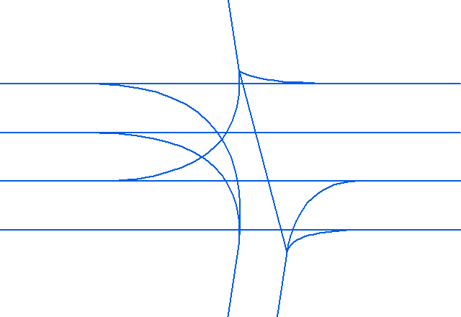
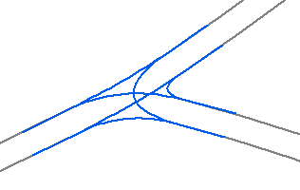
Presentation Graphics
ArcNet with curved connections
Version 4
Version 5

